Slide 1
Tampa Bay Chapter of ISSA
Women in Security: Building for the Future
Marci McCarthy, CEO & President, T.E.N.

Slide 2
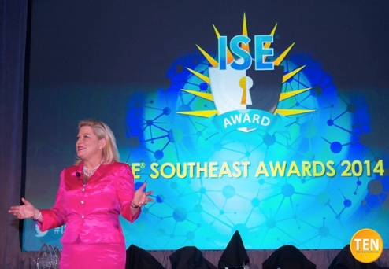
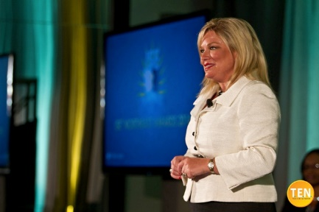
My Story
Started my career in the InfoSec industry in 2000
Director of Product Marketing – Secureworks
Director of Marketing - Lancope
Founded three companies ---Executive Alliance, T.E.N. and ISE® Talent
Created the ISE® Award Program Series
Nationally acclaimed as North America’s largest recognition program for security professionals
2012 Recipient of a 4th Congressional District of Georgia Citation for fostering greater visibility and professionalism for the IT security industry
Marci McCarthy
CEO and President
T.E.N.

Slide 3
What did you want to be when you grew up?
Notes:
What did you want to be when you grew up? I bet none of you thought you wanted to be Information Security!

Slide 4
Information Security is Transforming
Diversity will shift the balance, the playing field toward defenders rather than attackers
Information security becoming less focused on technology, more focused on people
Evolve from technical operational focus to more comprehensive, risk-based business orientation
Effective transformation will require advocacy of continuous education, community building and ability to balance subtleties of risk and business objectives
Crucial to increase the number of women
Notes:
Now is the time to build for the future. No longer a career for only men. Women have a lot to bring to the table.

Slide 5
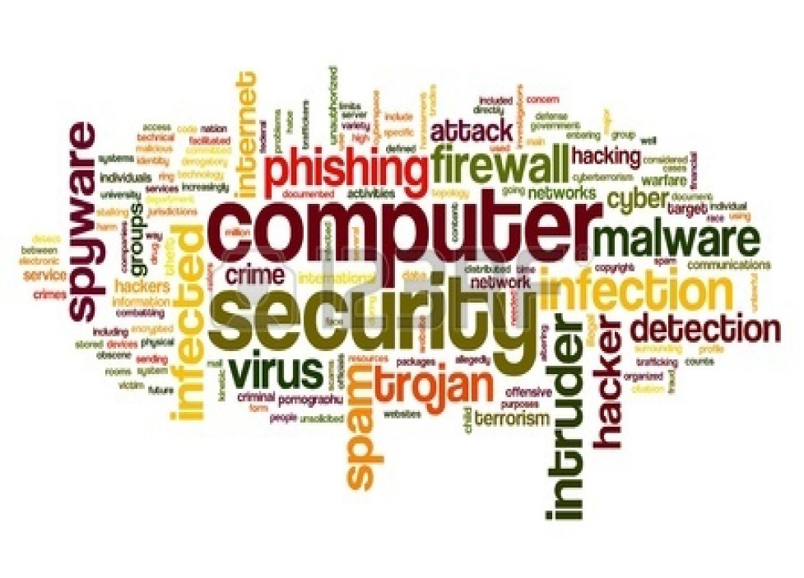
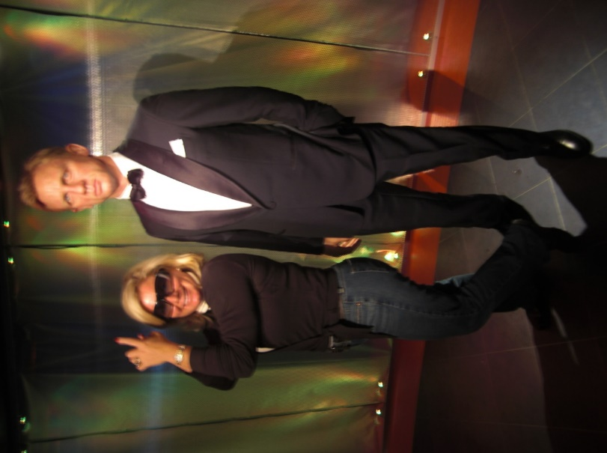
Women are the Agents of Change
Have the skills and perspectives that align with the traits needed to transform the direction, operating practices, and priorities of security organizations
Growing importance of communication, multifactorial analytics capabilities, empathy skills
Cross-organizational relationship building and collaboration
More likely to engage in people development, participative decision-making and other leadership activities that help companies succeed
If half of technology users are women, it only makes sense for leadership in technology and security to be reflective of this.

Slide 6
Why choose a career in security?
Notes:
Women have the potential to change the future of security.

Slide 7
InfoSec is a HOT Career!
Information security jobs are expected to grow by 53% by 2018
Bureau of Labor Statistics
25% of all organizations have a problematic shortage of information security skills
Network World 2014
Among the most sought-after professionals in the tech sector with demand for workers in cyber security field outpacing the other IT jobs by a wide margin
CIO Magazine 2014
Demand for cyber security profs has grown more than 3.5x faster than the demand for other IT jobs over the past 5 years and more than 12x faster than the demand for all other non-IT jobs. Current staffing shortages are estimated between 20,000 and 40,000 and are expected to continue for years.
Burning Glass International

Slide 8
Benefits of a Career in Security
Growing Demand
Companies are starting to take information security very seriously
Stability - low unemployment
High compensation
Significant Impact
Mission critical roles
Field is diverse
You get to make the rules
Your work is meaningful
Consistent and evolving challenges

Slide 9
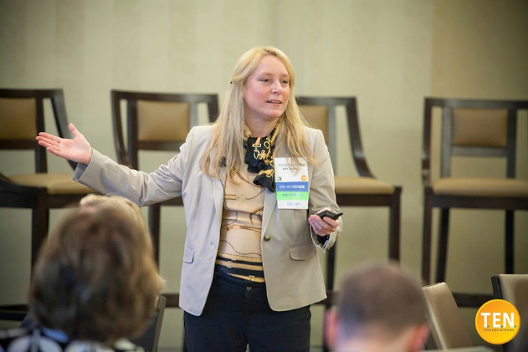
Wide Array of Opportunities
Leadership: CISO, CSO, CIO
Management: Information Security, Risk, Fraud, Audit, Compliance, Program, Project, Services
Auditor: Governance Analyst, Risk Analyst, Compliance Analyst
Security Principle: Security Architect, Engineer, Analyst, Administrator
Specialty Roles: Security Assurance, Penetration Tester, Forensics and Litigation Support, Threat Intelligence, Application Security, Security Software Developer, Identity Management, Cryptographer
Solution Providers: Leadership, Engineering, Development, Marketing, Sales, Product Management, Communications
Business and Advisory: Entrepreneur, Consultant

Slide 10
$how Me the Money!
Source: InfoSec Institute
Notes:
CISO personnel with experience of less than ten years will find salaries at a major corporation that range from $140,000 to $150,000 per year. After 10 years, salaries typically jump to $160,000 and may climb to $180,000 with appropriate experience and advanced education such as a postgraduate degree. These figures are based on national averages and vary according to the size of the company and the type of business. The ideal employer of a Director of Security realizes the importance of a full-time officer and allows a budget priority for their employment.

Slide 11
So you want a career in InfoSec? How do you get there?
Notes:
Women have the potential to change the future of security.

Slide 12
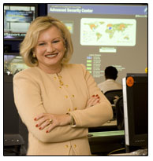
Success is Found on Many Different Paths
Information security is one of the fastest growing professional careers
Organizations looking to hire women
No one path of entrance; education, curriculum or degree or career advancement
Passion, enthusiasm and willingness to learn can take you in the direction of your choice
Abundance of roles in which women can thrive
The first woman CISO was in 1996
Rhonda MacLean
Global Chief Information Security Officer
Bank of America
Notes:
-- Steve Katz – Citigroup – Chief Information Security Officer – 1995
-- Rhonda MacLean – Bank of America – Global Chief Information Security Officer – 1996

Slide 13
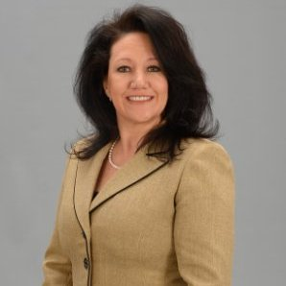
The Consulting Path: Shelbi Rombout
Her Path: Consultant to Contractor to Project Manager to Recognized Leader
Original Focus: Deeply technical; not managerial
Biggest Break: Asked to help build the program management office at her company
Gave her a new perspective of technology
Gave her experience managing people
Enabled her to understand the business and approach technology via strategic planning
Advice: The evolving threat landscape create an environment of continuous education, research and collaboration – embrace it!
Shelbi Rombout IAM Management Executive US Bank
“Our opportunities are only limited by our personal fears or self-imposed boundaries.”

Slide 14
The Sales & Marketing Path: Denise Hayman
Started with Symantec in 1990 – Knew there were many areas to grow
Michelangelo Virus hit in 1991 – Need for security became very real
BA in Education w/ Secondary in Math, but believes data analytics is important
Biggest Break – took over region that had not performed in two years
Advice: Keeping up with the trends, whether on the technical side or the sales and marketing side is the most important thing.
“The cyber security industry is woefully understaffed. This field will only grow every single year. Job opportunities will only continue to grow and expand. It’s a great career choice!”
Denise Hayman SVP of Global Sales Vendavo
Notes:
A career in security is one which has continuous challenges to be solved. The perpetrators are so different than they were even a year ago. This is a fast changing industry. Holes are plugged and new ones found every day. Finding the security holes and taking advantage of them has become a lucrative business. Drug cartels and all other criminal types have become very tech savvy. Whether it’s brazen site take downs or small filtering of 10 or 40 cents every credit card transaction. They are fueled by lots of money, available work forces with time on their hands and a level of technical expertise that has been developed over years of screen time. Secret, hidden paths of communication, This ‘darknet’ is growing at more than 40% every year.
This means keeping up with the trends, whether on the technical side or the sales and marketing side is the most important thing. Keeping up on the news, the latest trends and networking with those in the know. Staying relevant. Balancing and networking with the right groups becomes very important. The community is starting to band together to share and try to get ahead of the threats. Sharing threat information is getting to be more commonplace. For women in particular there are also starting to be groups where you can network and get information and knowledge.

Slide 15
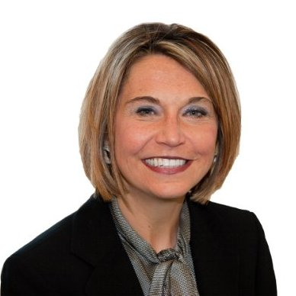
The Audit Path: Julie Talbot-Hubbard
Started in 1999 – audit and resiliency
Made a move to risk management and cyber security
Biggest Break: Early in her career, her manager left and she became the interim director – this was her first step into leadership
Second Big Break: Winning the ISE® Award was a game changer; it gave me confidence and recognition in the industry
Advice: Get involved in FIRST and/or engineering programs as a young adult to build knowledge and confidence. Get an internship in the Cyber Security or Risk Management domains
“Our opportunities are only limited by our personal fears or self-imposed boundaries.”

Slide 16
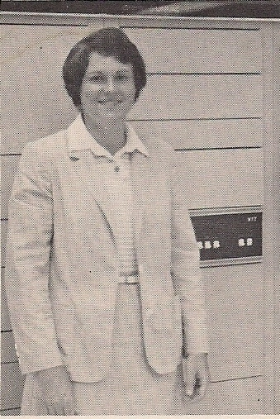
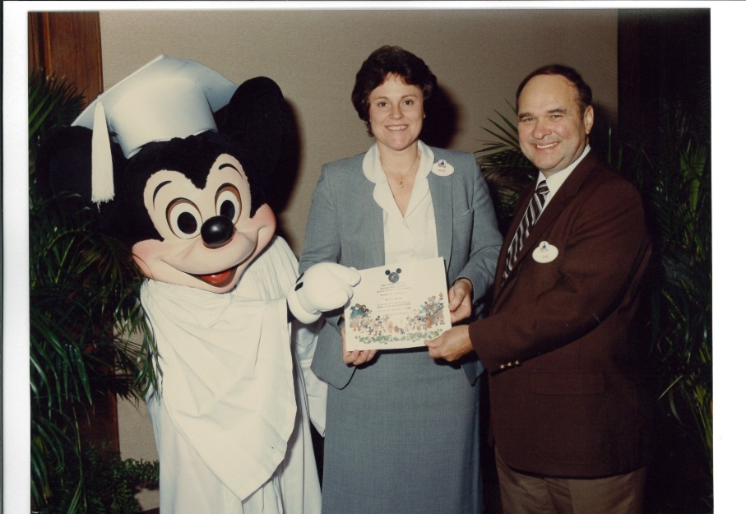
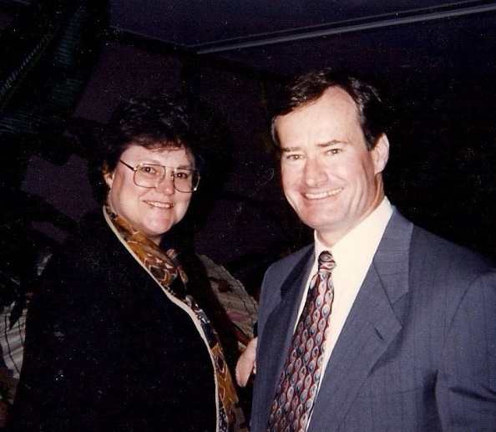
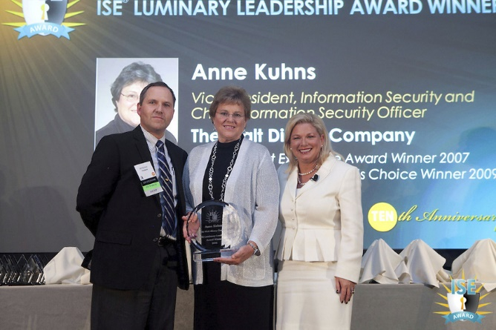
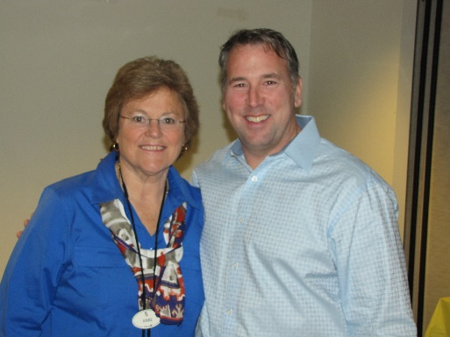
The Tech-to-CISO Path: Anne Kuhns
First day at Disney - 1978
Data Center 1982
Disney University - 1984
Last day as CISO - 2013
Leadership - 1995
ISE® Luminary Leadership Award - 2012
Notes:
I’m sure there are many of you sitting in the audience wondering if it is even possible for a female in an entry level position to grow into one of the industry’s most influential leaders. Well, I’m here to show you the perfect example. On this slide you see photos of Anne Kuhns, retired Chief Information Security Officer for The Walt Disney Company. These photos represent her journey from her start at Disney, her progress into leadership, and finally her last day on the job. Anne has been one of the greatest examples of leadership and vision that the industry has ever known, but because I could not do her story justice - she is here to tell you herself. Anne, will you please join me.

Slide 17
Being a woman gives you an edge
Use your gender to your advantage!
You stand out more when you are successful
You have more refined communication skills
You have superior management skills
Better at multitasking
As a woman, your ability to analyze data, data metrics and combine it with your gut instinct is a combination that is extremely powerful
Notes:
Most people talk about all the limitations to being a female in technology, but being a woman can give you an edge. Use your gender to your advantage!

Slide 18
Do Not Roll The Dice: Make a Plan!
Begin with the end in mind – where do you want to be in 1, 5, 10 years?
Consider what experiences and career paths you might enjoy
Work on your weaknesses
Seek out training and opportunities to advance your knowledge
Online learning resources:
Cyber Security Awareness Free Training and Webcasts
NIH Information and Privacy Awareness Training
Securitytube training videos
Sectools.org: Top network security tools
Coursera: partners with top universities to offer free education courses online

Slide 19
Advance Your Knowledge
Online learning resources:
Cyber Security Awareness Free Training and Webcasts
NIH Information and Privacy Awareness Training
Securitytube training videos
Sectools.org: Top network security tools
Coursera: partners with top universities to offer free education courses online
Scholarships:
ISC² Scholarship opportunities:
Scholarship for Women Studying Information Security
Undergraduate Scholarship
Graduate Scholarship
Harold F. Tipton Memorial Scholarship
U.S.A. Cyber Warrior Scholarship
University of Phoenix (ISC)² Scholarship

Slide 20
Top Schools for Cybersecurity
University of Southern California
University of Pittsburgh
George Mason University
West Chester University of PA
U.S. Military Academy, West Point
University of Washington
University of Central Florida
Florida State University
Nova Southeastern University
University of Texas, San Antonio
Norwich University
Mississippi State University
Syracuse University
Carnegie Mellon University
Purdue University
Kennesaw State University
Clemson University

Slide 21
Invest in Your Career
Go after security related certifications
Attend conferences to network and build your knowledge/skill sets
Learn the hard skills AND the soft skills
Go where the opportunity is
Meet with recruiters, consultants, etc… they know where the jobs are

Slide 22
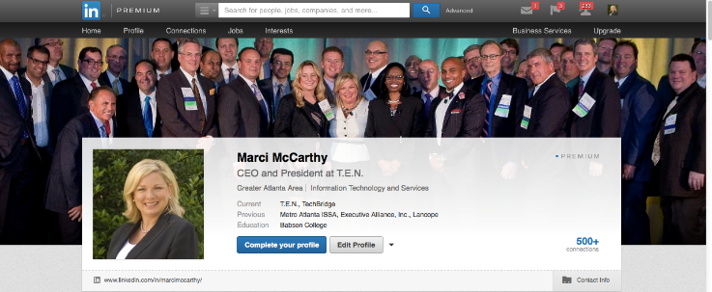
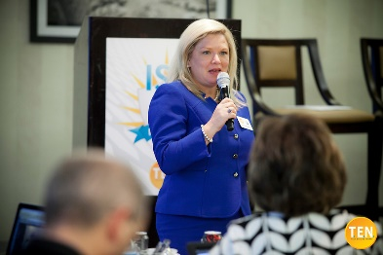
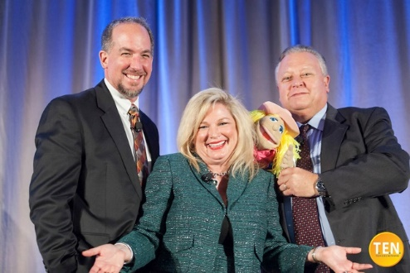
Create Your Personal Brand
Invest time in building your LinkedIn Page
Answer questions on LinkedIn and discussion forums
Position yourself as a knowledgeable leader in your company
Seek out opportunities that align with your goals
Take advantage of opportunities to speak/present
Publicize your accomplishments

Slide 23
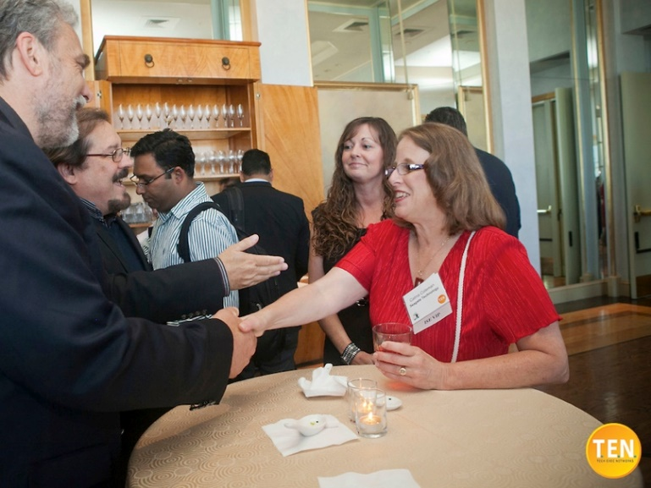
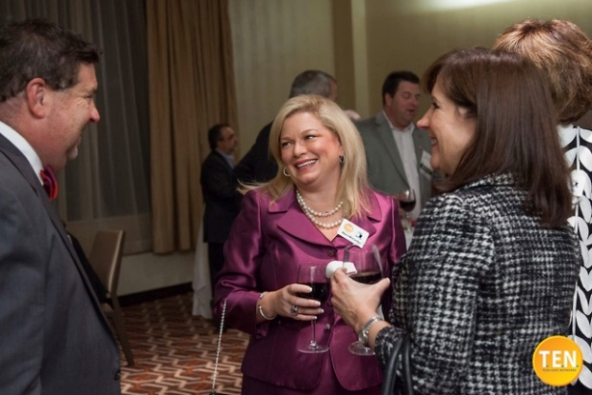
Building Your Network
Join and get involved with a professional organization
ISSA, Women in Technology, ASIS, EWF, ISC²
Get a mentor
ASIS and ISC² have mentoring groups
Take advantage of specialized, security-focused educational opportunities

Slide 24
Groups for Women in Security
Women Who Code
Girls Who Code
Girl Develop IT
Executive Women’s Forum
Women in Cyber Security
Women’s Security Society
Women in Technology Meet-ups
Women-friendly Hackerspaces
ISSA: Women in Security SIG

Slide 25
InfoSec Leadership: Making the Transition
Notes:
Women have the potential to change the future of security.

Slide 26
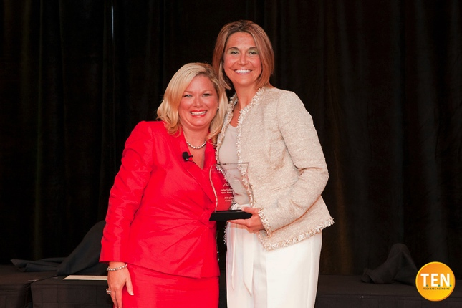
Know the Pieces to the Puzzle
“I feel security is a broad domain and includes multi-facets to encompass confidentiality, integrity and availability. One needs to understand the compliance requirements, threat & vulnerability aspects, and overall risk management to accomplish business resiliency. To engage in meaningful dialogue with the business, I would recommend individuals have a background encompassing all facets to be able to communicate in business risks terminology.”
Julie Talbot-Hubbard Associate Vice President, IT Engineering Nationwide Insurance

Slide 27
Tips for the Transition
Understand the business – A manager does more than perform a job; you must understand the business and be able to articulate your team’s needs as a business enabler
As a woman you have insights and intuition that almost none of your male counterparts possess. Use them.
Embrace the opportunity to make difficult decisions; this is how leaders bring change
Don’t expect to have all the answers; don’t be afraid to ask questions
Seek guidance when building your managerial skills; these must be practiced and refined just like tech-related skills
Remember that integrity matters above all else

Slide 28
Integrity and Leadership
Today’s Cyber Pros Want Employers to Demonstrate Integrity and Leadership
Source: Semper Security – Cyber Security Census Report – August 2013

Slide 29
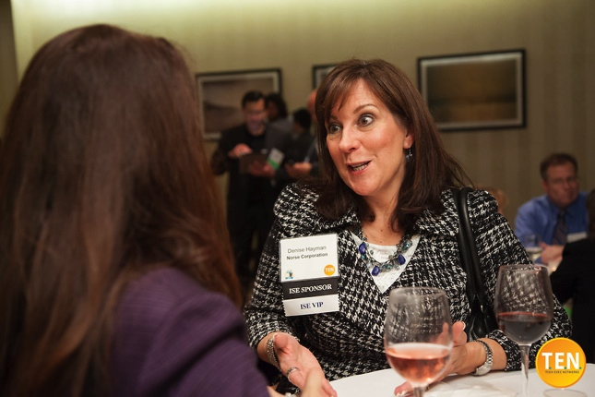
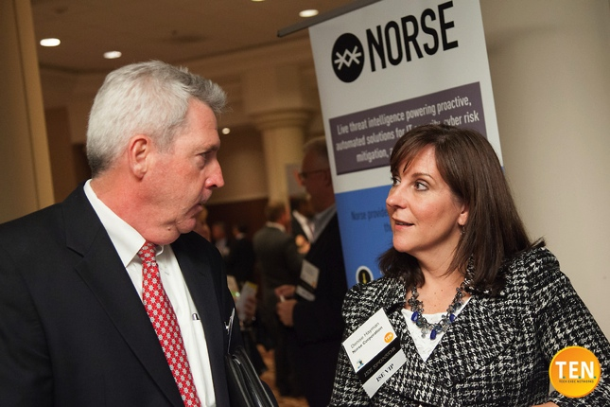
If you take away one thing…
“Don’t be afraid to take on a difficult challenge, it can be a career maker, a game changer for you. Recognize it when it comes your way. Volunteer for it, even.”
- Denise Hayman
Notes:
Remember: Nothing matters more than integrity. Be the leader they want to work for.
Utilize your network for referrals. Build your network via T.E.N. & ISE Programs.
Bring HR into the security conversation. Have recruiters sit in at meetings on projects to be lead. Have them learn the language and needs of your security organization.
Learn how to better articulate your needs to the board and hiring team. Position security as a business enabler. Advocate for the funding needed to hire the right people by articulating that security is one of your top priorities.

Slide 30
Thank you and Questions
Marci McCarthy
CEO and President
T.E.N
Direct: 404-920-8582 x101
Cell: 404.273.3045
mmccarthy@ten-inc.com
www.ten-inc.com| www.ten-isetalent.com
TENandISE
www.linkedin.com/in/marcimccarthy/

